Slide 1

A Mathematical Model for the Diffusion of Tumor Angiogenesis Factor into the Surrounding Host Tissue
Steven Hetrick
Andrew Januszko
Don. Crabs Smoking Cigarettes - Cancer, 25 Sept. 2015, https://knowyourmeme.com/photos/1021833-crabs-smoking-cigarettes. Accessed 25 Apr. 2022.

Slide 2
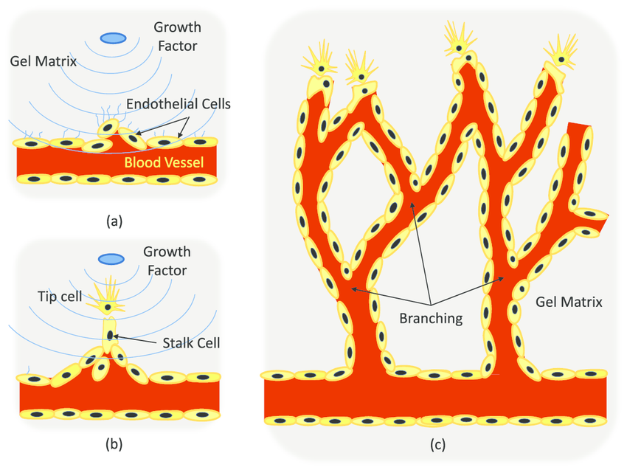
Background
Tumors are bad (and hungry).
They secrete a chemical called tumor angiogenesis factor (TAF).
TAF stimulates nearby endothelial and causes them to branch towards the tumor.
Once the branches reach the tumor, it is supplied with all the nutrients and oxygen it needs to grow.
This causes the tumor to stop secreting TAF.
Kamm, Roger D. “Angiogenic Sprouting Process. (A) ECS Residing in a Blood ...” Research Gate, https://www.researchgate.net/figure/Angiogenic-sprouting-process-a-ECs-residing-in-a-blood-vessel-sprout-out-in-response_fig1_220121784.

Slide 3
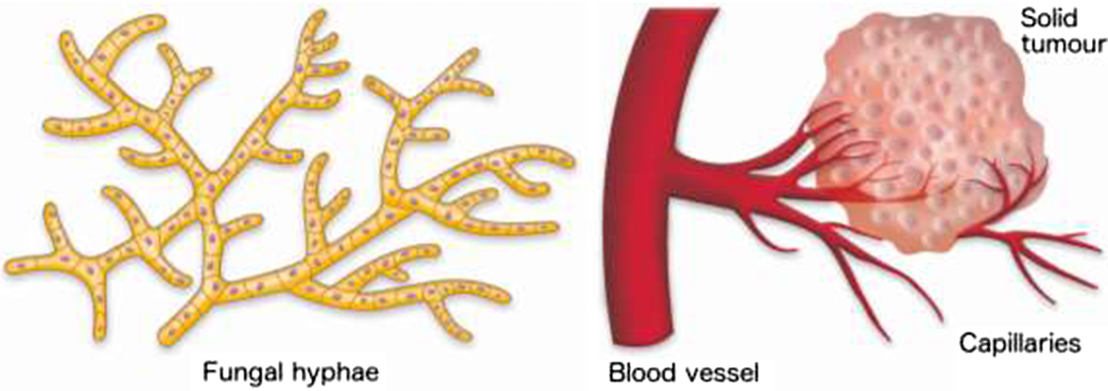
Previous Models
In previous models:
Capillary growth was based off existing fungal growth models.
TAF production was based off existing TAF production models inside the tumor.
Flegg, Jennifer A. A Current Perspective on Wound Healing and Tumour-Induced Angiogenesis, Springer Link, 22 Jan. 2020, https://www.google.com/search?q=fungal+growth+vs+capillaries&client=safari&rls=en&sxsrf=APq-WBuZZpfWvXE6nQnJYVHcOcQS4ao82Q:1650940938085&source=lnms&tbm=isch&sa=X&ved=2ahUKEwjQo6Oh2rD3AhXyYN8KHSg6DXQQ_AUoAXoECAEQAw&biw=1512&bih=864&dpr=2#imgrc=b7ZE3KxRGX2fRM. Accessed 25 Apr. 2022.

Slide 4
What Makes This Model Special?
This new model adds the following features:
Consideration for finite boundaries for TAF absorption.
Critical distance between the tumor and the neighboring endothelial cells.
A natural decay and sink term for TAF.
Endothelial Cells
Boundary
Tumor

Slide 5
Variables
This model has the following variables
D is the diffusion rate of TAF into the host tissue.
g(c) is the absorption rate of TAF into the host tissue.
This is later replaced by a constant m.
c is the concentration of TAF.
c_{b} at the edge of the tumor
0 at the free border
f is the sink term for endothelial cells consuming TAF.
s is the position of the free border.
x is a position in 1D space
X is a position relative to the position of the free border.
a is a position of proliferating endothelial cells.

Slide 6
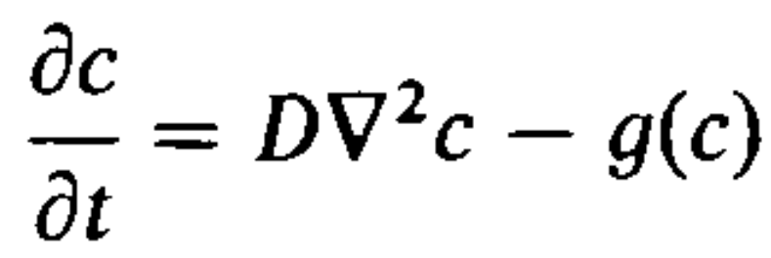
New Model, 1
This new model tracks the concentration of TAF over time by calculating the difference of the diffusion rate and the absorption rate of the host tissue.
This model assumes the following:
The concentration is the highest on the edge of the tumor and the lowest at the edge of the free border.
Change in Concentration
Diffusion Rate
Absorption Rate
TAF Concentration
Tumor
Free Border

Slide 7
Assumptions
New assumptions for the revised model include:
The position of the tumor is x = 0.
The position of the free border is at x = s.

Slide 8
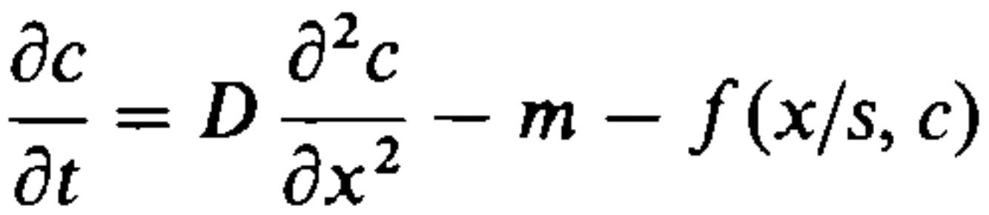
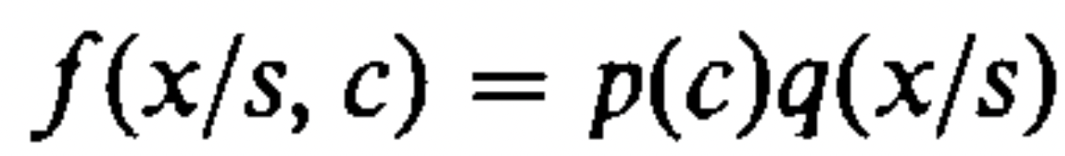
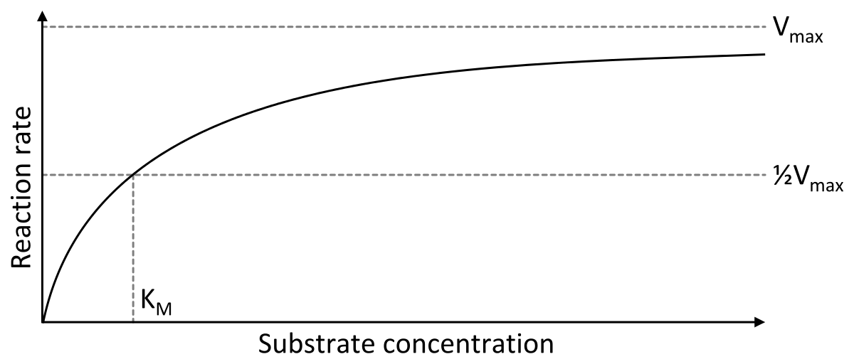
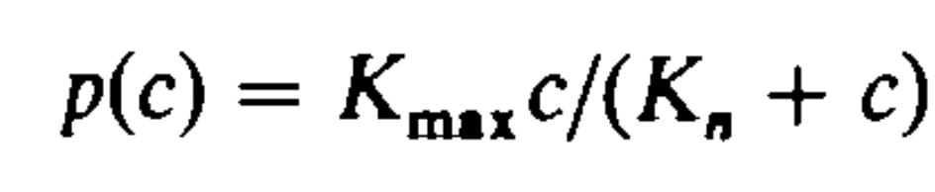
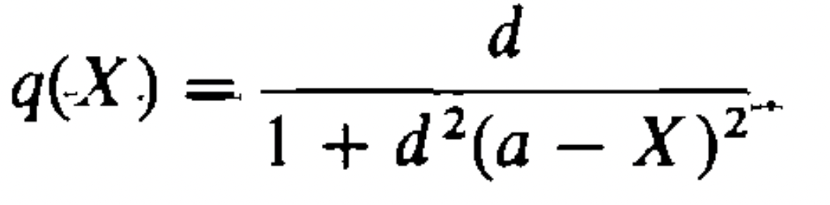
New Model, 2
Change in Concentration
Absorption Rate (Surrounding Tissue)
Absorption Rate (Capillaries)
Diffusion Rate
This model is a revision of the new one, with parameters added for capillaries consuming the TAF as they grow towards the tumor.
Absorption Rate (Capillaries)
Concentration of TAF
Spatial uptake of TAF
Concentration of TAF
Shafee, Thomas. “Michaelis–Menten Kinetics.” Michaelis–Menten Kinetics - Wikipedia, Wikipedia, 14 Mar. 2018, https://www.google.com/url?sa=i&url=https%3A%2F%2Fen.wikipedia.org%2Fwiki%2FMichaelis%25E2%2580%2593Menten_kinetics&psig=AOvVaw3XB1BG8Zdy-F2zN9CDpTE3&ust=1651018667851000&source=images&cd=vfe&ved=0CA0QjhxqFwoTCNiDwYO6sPcCFQAAAAAdAAAAABAU. Accessed 25 Apr. 2022.
Spatial uptake of TAF

Slide 9
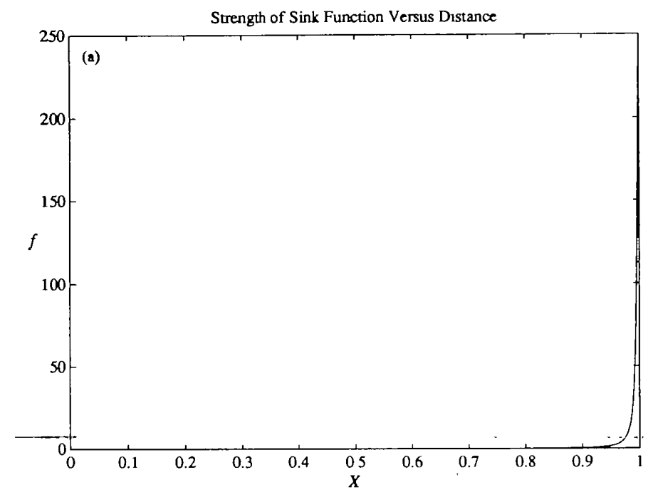
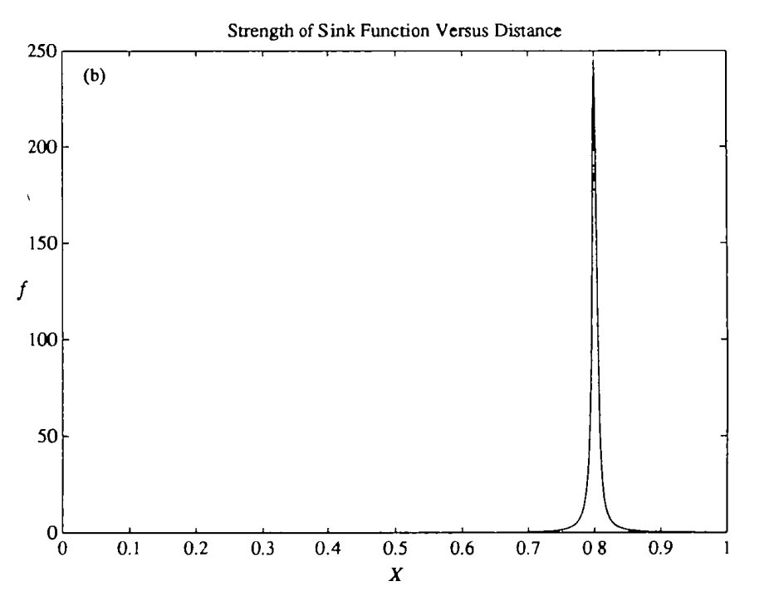
New Model, 3
The tables shown represent the strength of the sink function compared to a position relative to the free border
We can see that as the sink function nears the proliferating endothelial cells its strength increases, peaking at the exact position of the cells.
As it passes the cells, the strength decreases.

Slide 10
Results & Conclusion
When the tumor is removed, the TAF diffused away naturally over time.
This causes the TAF to eventually leave the system.
This brings the free border to x = 0.
When the TAF diffuses away, the deprived endothelial cells no longer grow towards the former location of the tumor.
This response is caused by the receding TAF concentration gradient.
Future research should look into:
Adding functions for the endothelial cell density or tip density

Slide 11
Any Questions?

